Slide 1
OPIM 5604
Predictive Modeling
Model Performance Metrics - Prediction
Jennifer Eigo, Instructor in-Residence

Slide 2
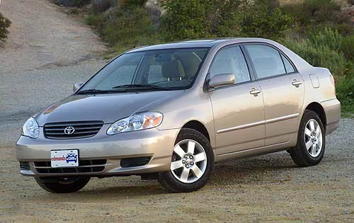
How well can we predict the price of a Toyota Corolla?
ID | Actual Price | Predicted Price
1 | 13500 | 17438.28
3 | 13950 | 17408.35
5 | 13750 | 16635.56
6 | 12950 | 15886.27
8 | 18600 | 15855.60
9 | 21500 | 21023.88
10 | 12950 | 15671.82
11 | 20950 | 21058.47
12 | 19950 | 21224.92
13 | 19600 | 21043.28

Slide 3
Continuous Assessment Metrics
  Residual = Actual – Predicted
  MAPE (mean absolute percentage error)
  = average(|Actual – Predicted|/Actual)
  RMSE (root mean square error)
  = sqrt(average((Actual – Predicted)^2)))
  also called RASE in some places
  R² (R squared)
  = 1 – (SS_{res} / SS_{tot})

Slide 4
Residual = Actual - Predicted
  Negative residual means we predicted too high
  Positive residual means we predicted too low
  Calculated for each row
ID | Actual Price | Predicted Price | Residual
1 | 13500 | 17438.28 | -3938.28
3 | 13950 | 17408.35 | -3458.35
5 | 13750 | 16635.56 | -2885.56
6 | 12950 | 15886.27 | -2936.27
8 | 18600 | 15855.60 | 2744.40
9 | 21500 | 21023.88 | 476.12
10 | 12950 | 15671.82 | -2721.82
11 | 20950 | 21058.47 | -108.47
12 | 19950 | 21224.92 | -1274.92
13 | 19600 | 21043.28 | -1443.28

Slide 5
MAPE (mean absolute percent error)
  MAPE = average(|Actual – Predicted|/Actual)
  Lower is better
  Average the last column to get MAPE = 0.15 = 15%
ID | Actual Price | Predicted Price | Residual | ABS(Residual)/Actual
1 | 13500 | 17438.28 | -3938.28 | 0.29
3 | 13950 | 17408.35 | -3458.35 | 0.25
5 | 13750 | 16635.56 | -2885.56 | 0.21
6 | 12950 | 15886.27 | -2936.27 | 0.23
8 | 18600 | 15855.60 | 2744.40 | 0.15
9 | 21500 | 21023.88 | 476.12 | 0.02
10 | 12950 | 15671.82 | -2721.82 | 0.21
11 | 20950 | 21058.47 | -108.47 | 0.01
12 | 19950 | 21224.92 | -1274.92 | 0.06
13 | 19600 | 21043.28 | -1443.28 | 0.07

Slide 6
RMSE (root mean square error)
  RMSE = sqrt(average((Actual – Predicted)^2)))
  Lower is better
  Average the last column then take the square root to get RMSE = 2516.05
ID | Actual Price | Predicted Price | Residual | Square Residual
1 | 13500 | 17438.28 | -3938.28 | 15510012.04
3 | 13950 | 17408.35 | -3458.35 | 11960198.93
5 | 13750 | 16635.56 | -2885.56 | 8326453.65
6 | 12950 | 15886.27 | -2936.27 | 8621691.89
8 | 18600 | 15855.60 | 2744.40 | 7531708.10
9 | 21500 | 21023.88 | 476.12 | 226688.25
10 | 12950 | 15671.82 | -2721.82 | 7408290.41
11 | 20950 | 21058.47 | -108.47 | 11764.96
12 | 19950 | 21224.92 | -1274.92 | 1625419.51
13 | 19600 | 21043.28 | -1443.28 | 2083056.90

Slide 7
R Squared Example
  Measures the amount of variance in the target variable captured by the predictor variables
  Number typically between 0 and 1
  Higher is better
  R Squared = 1 – (SS_{res} / SS_{tot})
  SS_{res} = sum((Actual – Predicted)^2)
    Residual Sum of Squares
    Quantifies the quality of the predictions
  SS_{tot} = sum((Actual – Avg(Actuals))^2)
    Total Sum of Squares
    Quantifies the variance in the actuals

Slide 8
R Squared Example
  SS_{res} = sum((Actual – Predicted)^2)
  Add up the last column
  SS_{res} = 63,305,284.63
ID | Actual Price | Predicted Price | Residual | Square Residual
1 | 13500 | 17438.28 | -3938.28 | 15510012.04
3 | 13950 | 17408.35 | -3458.35 | 11960198.93
5 | 13750 | 16635.56 | -2885.56 | 8326453.65
6 | 12950 | 15886.27 | -2936.27 | 8621691.89
8 | 18600 | 15855.60 | 2744.40 | 7531708.10
9 | 21500 | 21023.88 | 476.12 | 226688.25
10 | 12950 | 15671.82 | -2721.82 | 7408290.41
11 | 20950 | 21058.47 | -108.47 | 11764.96
12 | 19950 | 21224.92 | -1274.92 | 1625419.51
13 | 19600 | 21043.28 | -1443.28 | 2083056.90

Slide 9
R Squared Example
  SS_{tot} = sum((Actual – Avg(Actuals))^2)
  Avg(Actuals) = 16,770
  Compare each actual to the average and square that
  SS_{tot} = sum of the last column = 118,266,000
ID | Actual Price | Predicted Price | Actual – Average | (Actual – Average)^2
1 | 13500 | 17438.28 | -3270 | 10692900
3 | 13950 | 17408.35 | -2820 | 7952400
5 | 13750 | 16635.56 | -3020 | 9120400
6 | 12950 | 15886.27 | -3820 | 14592400
8 | 18600 | 15855.60 | 1830 | 3348900
9 | 21500 | 21023.88 | 4730 | 22372900
10 | 12950 | 15671.82 | -3820 | 14592400
11 | 20950 | 21058.47 | 4180 | 17472400
12 | 19950 | 21224.92 | 3180 | 10112400
13 | 19600 | 21043.28 | 2830 | 8008900

Slide 10
R Squared Example
  Solve for R Squared
  R Squared = 1 – (SS_{res} / SS_{tot})
  R Squared = 1 – (63305284.63 / 118266000)
  R Squared = 0.46
  How do we interpret this number? The model can describe 46% of the variance in the price of a car.
  Disclaimer: This is a small example with just 10 cars so I wouldn’t expect very good results! More rows will yield better results!

Slide 11
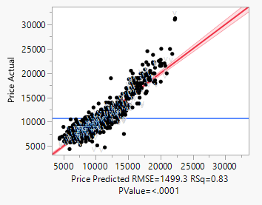
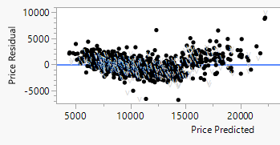
Visualize Performance
  Actual by Predicted
  Residual by Predicted

